Slide 1
Descriptive Statistics
Content
Introduction
Importance
TYPES
APPLICATIONS
Illustration
Completion by level of Program
Effects of Tuition fees on Endowment assets
References

Slide 2
Introduction
Descriptive statistics: term used to describe the analysis of data.
Helps describe, show or summarize data in a clear way.
Used by Researchers to Report on Populations and Samples.
In Sociology: Summary descriptions of measurements about a group of people.
Speed Up and Simplify Comprehension of a Group’s Characteristics.

Slide 3
Importance
Helps understand raw data
Facilitates visualization of raw data
Easy method of parsing through a large volume of data
Serves as a medium for presenting data in a clear and concise way.

Slide 4
Types
Types of descriptive statistics:
Organize Data
Tables
Graphs
Summarize Data
Central Tendency
Variation

Slide 5
Applications
In schools to find test score average.
Simplifying large amounts of data at work.
Finding the mean median and mode.
Processing research data.

Slide 6
Sample vs. Population
Sample
Population

Slide 7
Illustration
Which Group is Smarter?
Class A--IQs of 13 Students
112 110
131 107
145 86
93 101
150 116
97 94
120
Class B--IQs of 13 Students
117 152
121 101
95 110
83 107
91 77
130 105
108

Slide 8
Which group is smarter now?
Class A--Average IQ 108.54
Class B--Average IQ 107.5
The average is more or less the same.
With a summary descriptive statistic, it is much easier to answer our question.

Slide 9
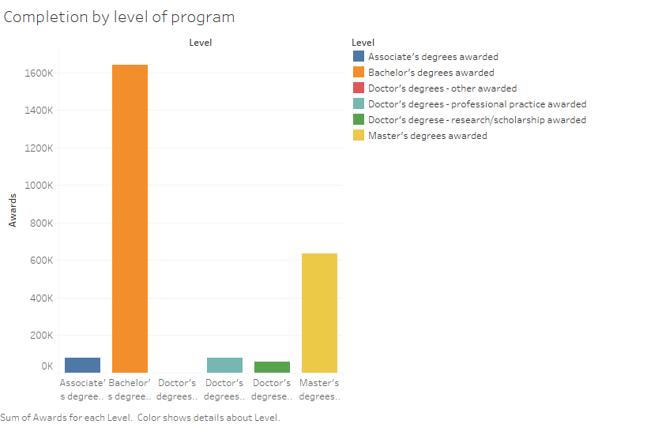
Completion by level of Program
Bachelor’s degree level has the highest completion number.
Master’s degrees comes is second best.
Highest completion by level is at 1600k awards.
Lowest completion by level is at 60k awards.

Slide 10
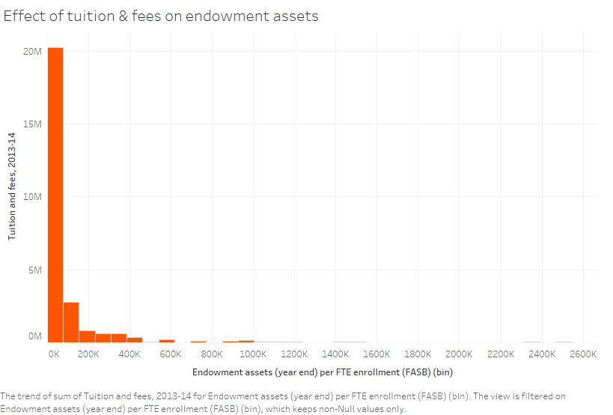
Effects of Tuition fees on Endowment assets
Endowment assets are inversely proportional to Tuition fees.
With a low endowment assets (year end), there’s a high sum of tuition fees (2013-2014).
An increase in the sum of tuition fees means a decrease in the endowment assets (year end).
The highest sum recorded in this period (2013-2014) is 20M.
With endowment assets of 1000k, the sum of tuition fee is almost zero.

Slide 11
References
Procheş, Ş. (2015). Descriptive statistics in research and teaching: are we losing the middle ground?. Quality & Quantity. 50. 10.1007/s11135-015-0256-3.

